Slide 1

Crypto Vote
Blockchain-Based Voting System

Slide 2
Introduction
Electronic voting systems have replaced paper-based systems, but even now, people doubt the voting system’s ability to secure the data and defend against any attacks.
The blockchain-based system can ensure transparent and publicly verifiable elections. If implemented successfully, voting can be done using a website or a mobile application that is attached to a blockchain system.

Slide 3
Idea
Each citizen has the right and the moral duty to vote. Now more than ever, being able to vote from the comfort and safety of our homes would be a great improvement that would make voting easier.
It's time to replace the archaic voting system with something new and secure. This is why we came up with CryptoVote, a blockchain-based voting solution.

Slide 4
Why Blockchain?
Because in an election every single vote needs to be accounted for. If the validity of the votes cannot be proven, then doubts may start to arise as to whether the results are valid, or if someone cheated. On the blockchain, because votes will be done via transactions, everyone will be able to see the validity of each vote, and the elections themselves can check a user's transaction history via a smart contract, so as not to allow duplicate votes.

Slide 5
Why Blockchain? …
A great use case for crypto vote could have been the 2020 United States presidential election, which not only took days for people to finish counting the votes, but is also still a debated subject - because of COVID, people were urged to send their votes via postal mail, but some people claim that the mail-in votes were fake.

Slide 6
Why Blockchain? …
With CryptoVote, everyone who has their doubts about an election can check the votes themselves. Also, results are known immediately once the election deadline ends, removing the need to wait, and the need to hire manpower to count the votes.

Slide 7
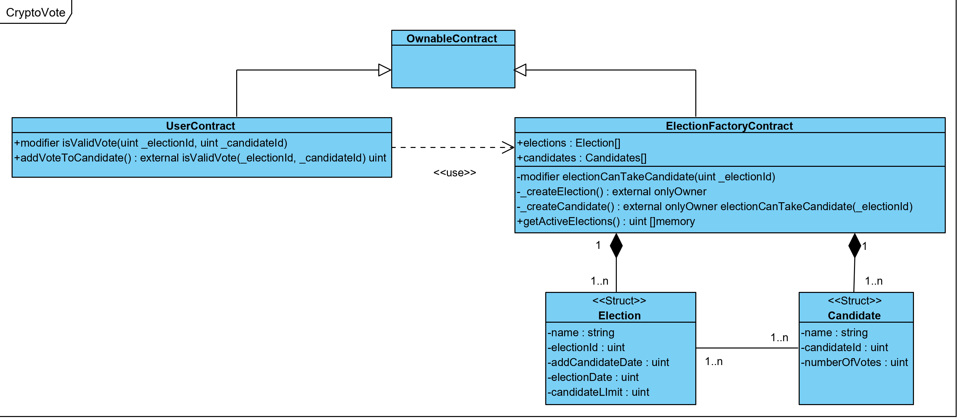
Design

Slide 8
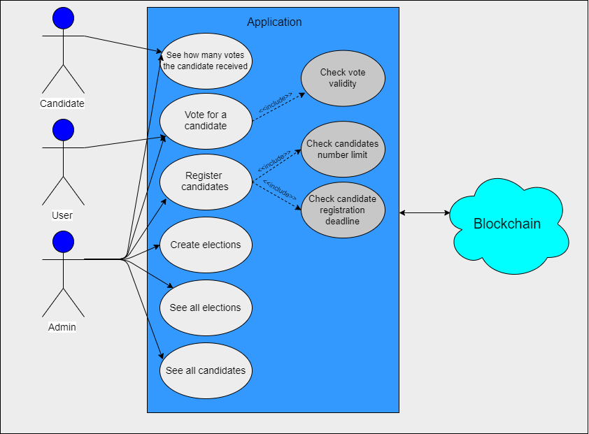
Implementation

Slide 9
Future Work
Signup (Voters):
In order to ensure that users do not vote multiple times by making multiple accounts, besides the email address, the frontend app would also require a CNP. If a user tries to create an account with a CNP that's already in use, the account will not be created.
Signup (Candidates):
In order to ensure that candidates are valid and eligible to vote, before they are added to the system, their information should be verified by an external authority.

Slide 10
Future Work
A possible future feature of the application would be to reward people who vote with visual stickers or icons (NFTs) that would appear on the user’s profile page.

Slide 11
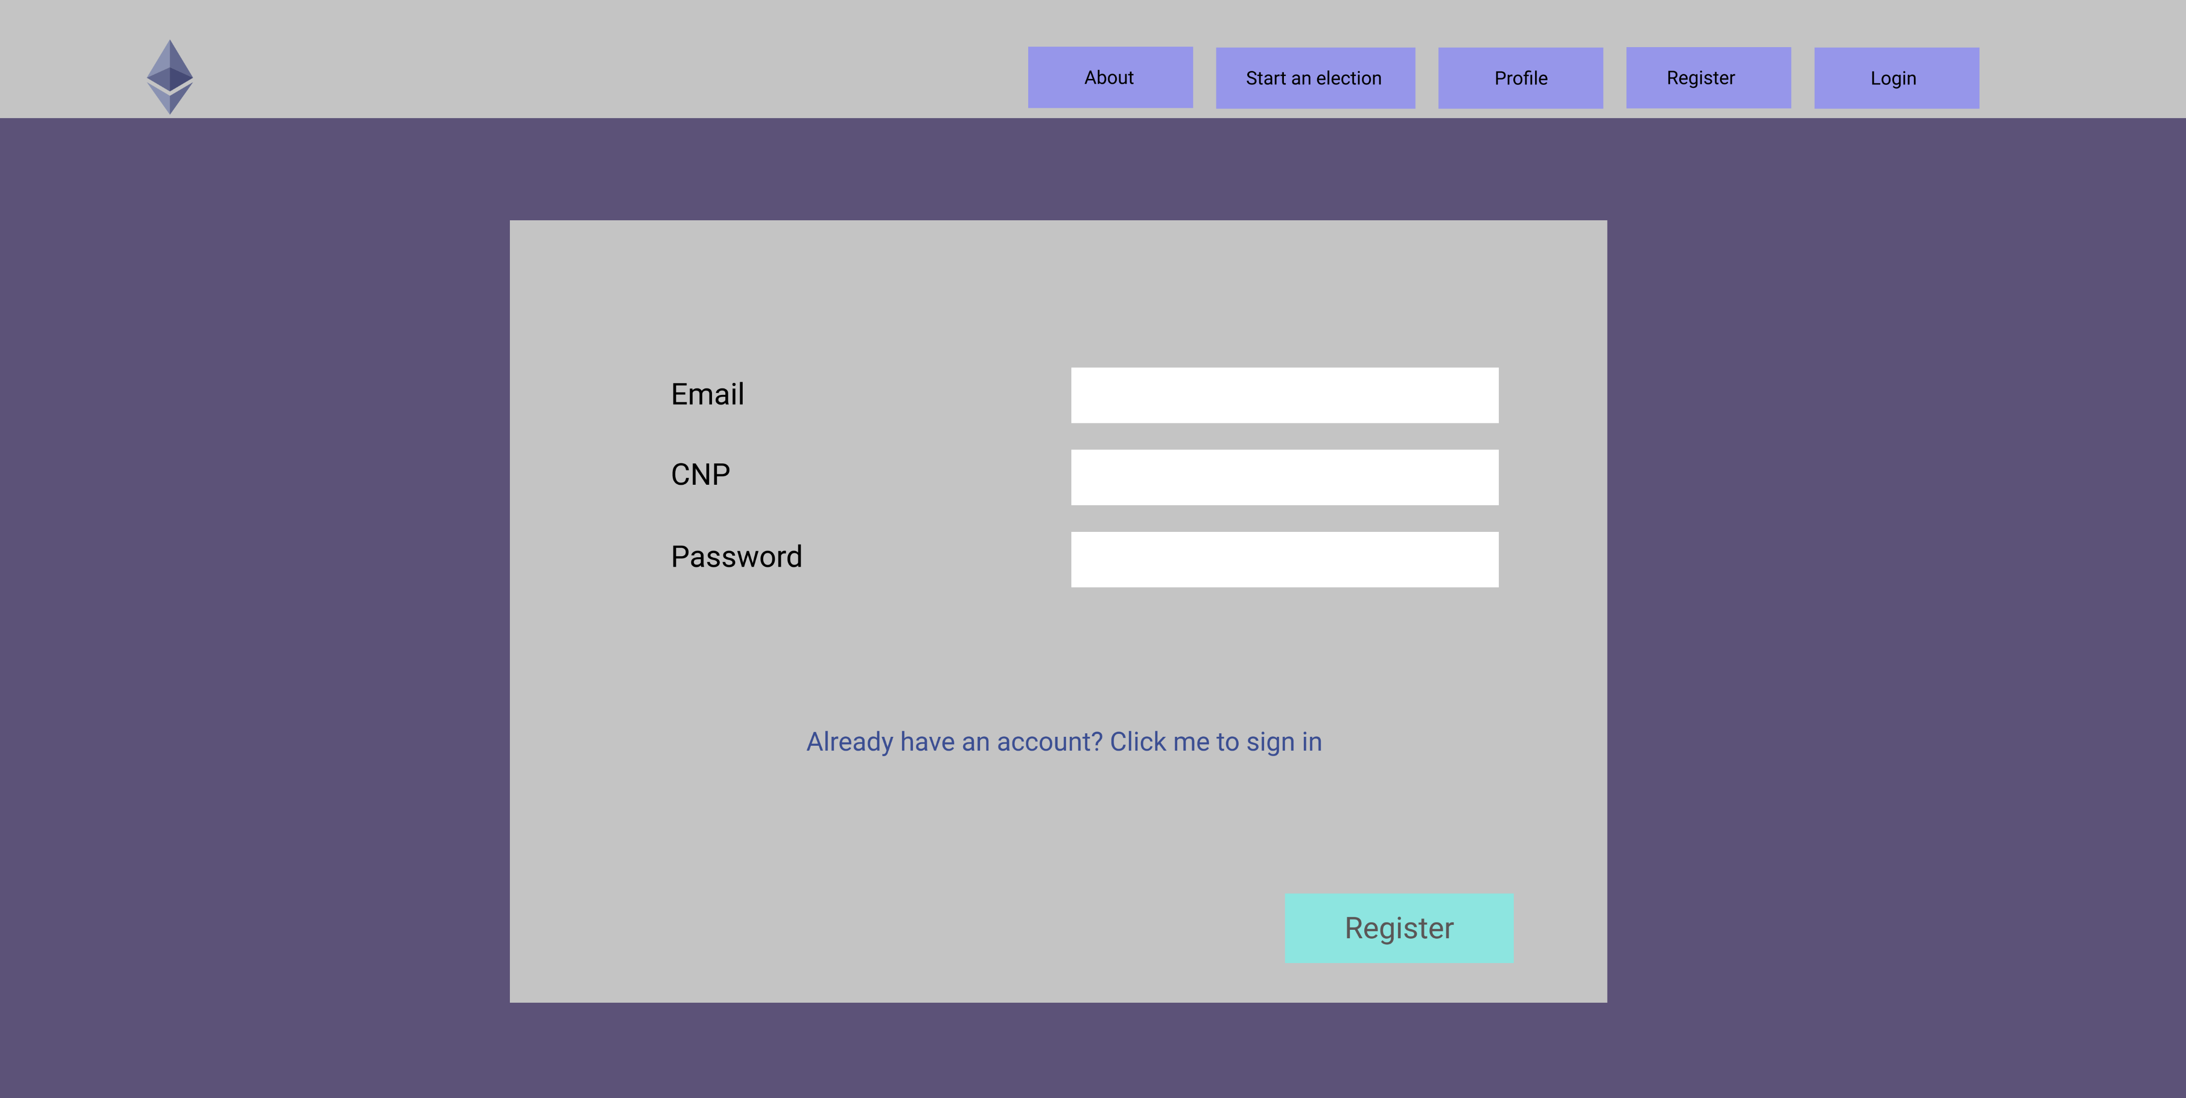
User Interface Mockups (SignUp)

Slide 12
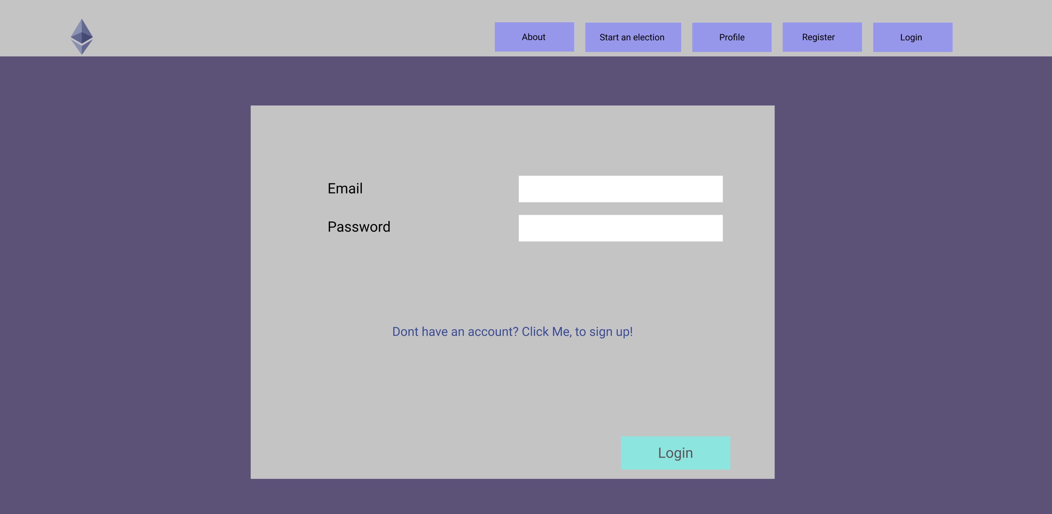
User Interface Mockups (Login)

Slide 13
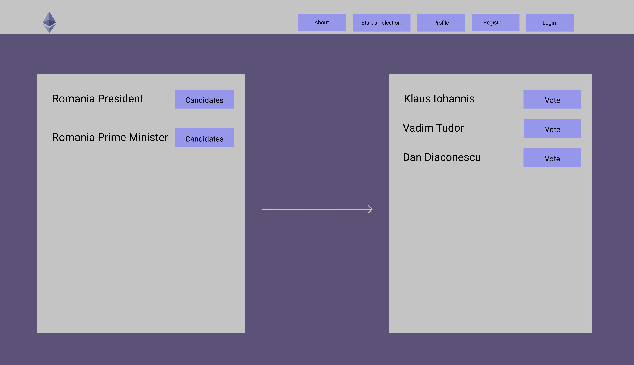
User Interface Mockups (Voting)

Slide 14
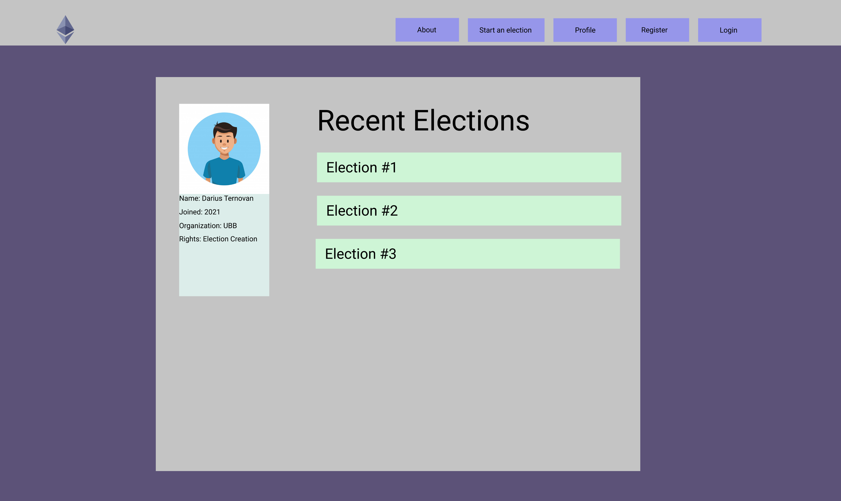
User Interface Mockups (Profile)

Slide 15
Team
Jamil Zaitouny
Darius Ternovan
Ianec Umanschii
Razvan Toma

Slide 16
Thank you!

